Slide 1
Flipped class material

Slide 2
Bottom up parsing
It starts from leaf nodes and works in upward direction.
Starts from a string or a sentence and apply production rules in reverse manner in order to reach to the start symbol.
It is called shift reduce parsing

Slide 3
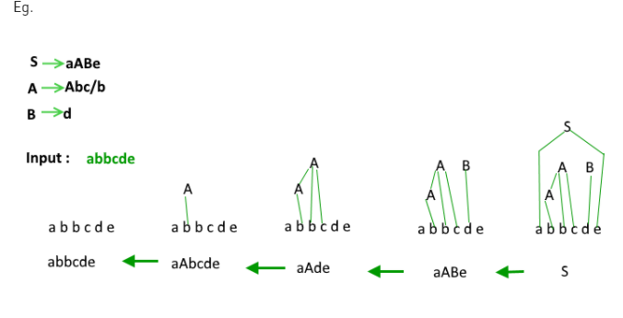
Example

Slide 4
Shift reduce parsing
Shift step: The shift step refers to the advancement of the input pointer to the next input symbol, which is called the shifted symbol. This symbol is pushed onto the stack. The shifted symbol is treated as a single node of the parse tree.
Reduce step: When the parser finds a complete grammar rule (RHS) and replaces it to (LHS), it is known as reduce-step. This occurs when the top of the stack contains a handle. To reduce, a POP function is performed on the stack which pops off the handle and replaces it with LHS non-terminal symbol.

Slide 5
LR parser
The LR parser is a non-recursive, shift-reduce, bottom-up parser. It uses a wide class of context-free grammar which makes it the most efficient syntax analysis technique.
LR parsers are also known as LR(k) parsers, where L stands for left-to-right scanning of the input stream; R stands for the construction of right-most derivation in reverse, and k denotes the number of look ahead symbols to make decisions.

Slide 6
SLR
Watch this video
https://www.youtube.com/watch?v=6K2JcULl4No&feature=youtu.be
The method of flipped class:
Based on the given material, students should do a study and in a live class the teacher will discuss and the active participation of the students also required for it.
Flipped class will be on next Tuesday: 1 to 1.50
Be prepare for that.

